Slide 1
Managing Your Small Woodland: Energize Your Woodland Investment
Indiana Watershed Leadership Academy
Phil Cox and Larry Owen
May 20, 2015
Notes:
This template can be used as a starter file for presenting training materials in a group setting.
Sections
Right-click on a slide to add sections. Sections can help to organize your slides or facilitate collaboration between multiple authors.
Notes
Use the Notes section for delivery notes or to provide additional details for the audience. View these notes in Presentation View during your presentation.
Keep in mind the font size (important for accessibility, visibility, videotaping, and online production)
Coordinated colors
Pay particular attention to the graphs, charts, and text boxes.
Consider that attendees will print in black and white or grayscale. Run a test print to make sure your colors work when printed in pure black and white and grayscale.
Graphics, tables, and graphs
Keep it simple: If possible, use consistent, non-distracting styles and colors.
Label all graphs and tables.

Slide 2
How do Woodlands Help Your Watershed?
Canopy Interception and Infiltration
Trees Consume Stormwater
Pollutant Removal and Phytoremediation
Streamside or Riparian Forest Buffers
Resources: Center for Watershed Protection, www.cwp.org has Urban Watershed Forestry Manuals:
Methods for Increasing Forest Cover in a Watershed
Conserving & Planting Trees at Development Sites
Urban Tree Planting Guide
Notes:
Give a brief overview of the presentation. Describe the major focus of the presentation and why it is important.
Introduce each of the major topics.
To provide a road map for the audience, you can repeat this Overview slide throughout the presentation, highlighting the particular topic you will discuss next.

Slide 3
Energize Your Woodland Investment
Classified Forest & Wildlands Program
Invasive Species Control
Timber Stand Improvement
Market Mature, Quality Trees
Protect Your Forest

Slide 4
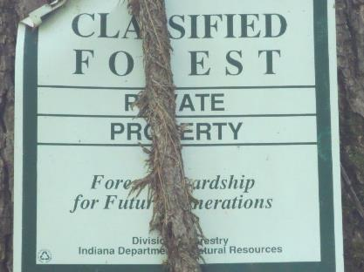
Classified Forest & Wildlands Program Indiana Division of Forestry
10 acres or more of forest or non-forest wildlife habitat.
Owner must agree to be good steward of the land and its natural resources.

Slide 5
Certain activities are not allowed
Grazing by domestic livestock
Building of houses, sheds, etc.
Intentional burning (unless in written management plan)
Growing Christmas trees

Slide 6
Other activities allowed
Wildlife management
Maintenance of access roads and trails
Timber harvesting
Firewood cutting
Horseback riding
Hiking
Hunting

Slide 7
The Indiana Natural Resources Commission met on May 19 to “define” improvements on Classified Forests and Wildlands.
Recreational Improvements allowed:
Hunting or wildlife viewing blinds must not be larger than 70 sq. ft.
Trails can be used for the following:
Running, hiking, horseback riding, biking, ATV/UTV, motocross, snowmobiling, snowshoeing or skiing.
Picnic shelters without utility connections.
Outhouse without utility connections.

Slide 8
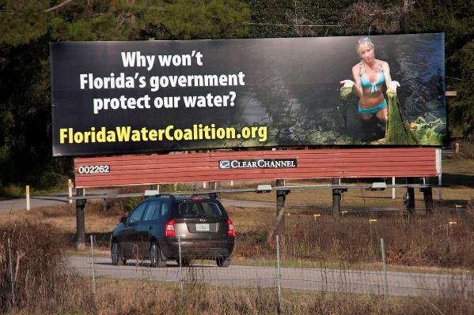
Miscellaneous Improvements Allowed
The following types of improvements are generally allowed provided there is no building attached to the improvement.
Windmills
Cell Phone Towers
Oil Derricks
Billboards
Utility Pole
Zip Line
Paint ball venues

Slide 9
Primary Benefits to the Owner
Reduced property taxes – the State of Indiana agrees to see that the assessed value of the land is reduced to $1 per acre, and taxed on that preferential assessment.
Regular inspection by a professional forester
Timber harvested recognized as “Green Certified”

Slide 10
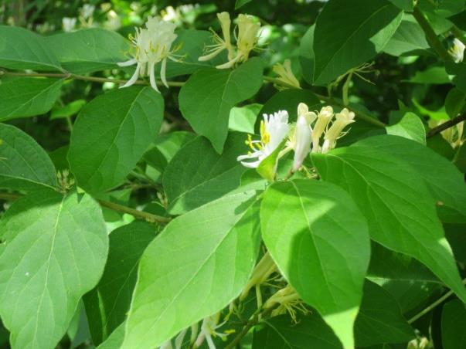
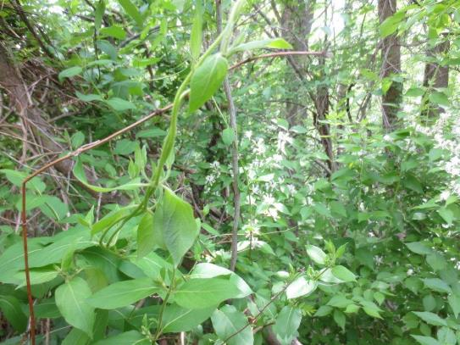
Invasive Species Control

Slide 11
Invasive Species Best Management Practices “Top Ten” List of IN Invasive Plant Advisory Committee
Develop an organizational Invasive Species Strategy
Create and maintain an Invasive Species knowledge base
Pre-plan major land development or maintenance activities
Use native plants/seeds and insure they are weed-free
Use clean landscaping material, i.e. mulch, fill, straw, gravel
Keep tools, equipment, vehicles and clothing clean
Have a long term-term plan for managing invasives
Monitor disturbed locations and high risk areas
Require contractors to follow BMPs
Educate recreational users on BMPs
More details at: http://www.entm.purdue.edu/iisc/pdf/IPAC_BMPs.pdf

Slide 12
Timber Stand Improvement (Woodland Weeding)
Growing the best trees = increased value
Release Crop Trees (Thin) to grow faster
Control Grape Vines
Remove Crooked, Defective and Low Value trees

Slide 13
Timber Stand Improvement will increase the annual return on your forest by 8% per year to about 18% per year with good crop trees.

Slide 14
Market Mature, Quality Trees
See a Forester to select your trees to harvest
Get an appraisal before selling
Solicit Bids
Have a contract to protect you and the forest
Get paid before trees are harvested
Don’t just sell your trees. Market and Manage them!!
A properly conducted sale will be profitable now and for the future of your forest.

Slide 15
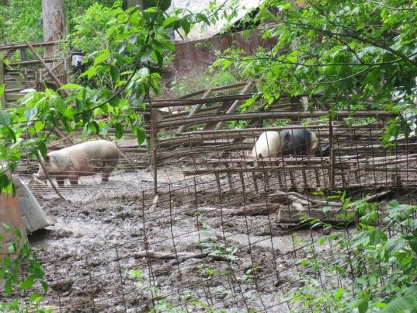
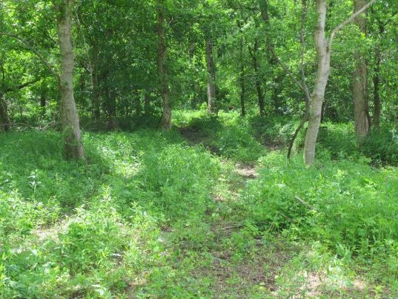
Protect Your Forest
Keep out livestock and don’t mow the understory
Control Fire
Maintain a crop of valuable new trees (seedlings)
Keep deer herd in balance by hunting bucks and does
Don’t “Fragment” your forest by developing. Small tracts become unfeasible to manage and are slowly cleared.

Slide 16
“forests are the most beneficial land use for protecting water quality, due to their ability to capture, filter, and retain water, as well as air pollution from the air. Forests are also essential to the provision of clean drinking water to over 10 million residents of the watershed and provide valuable ecological services and economic benefits including carbon sequestration, flood control, wildlife habitat, and forest products.” chesapeake bay executive council, 2006

